Slide 1
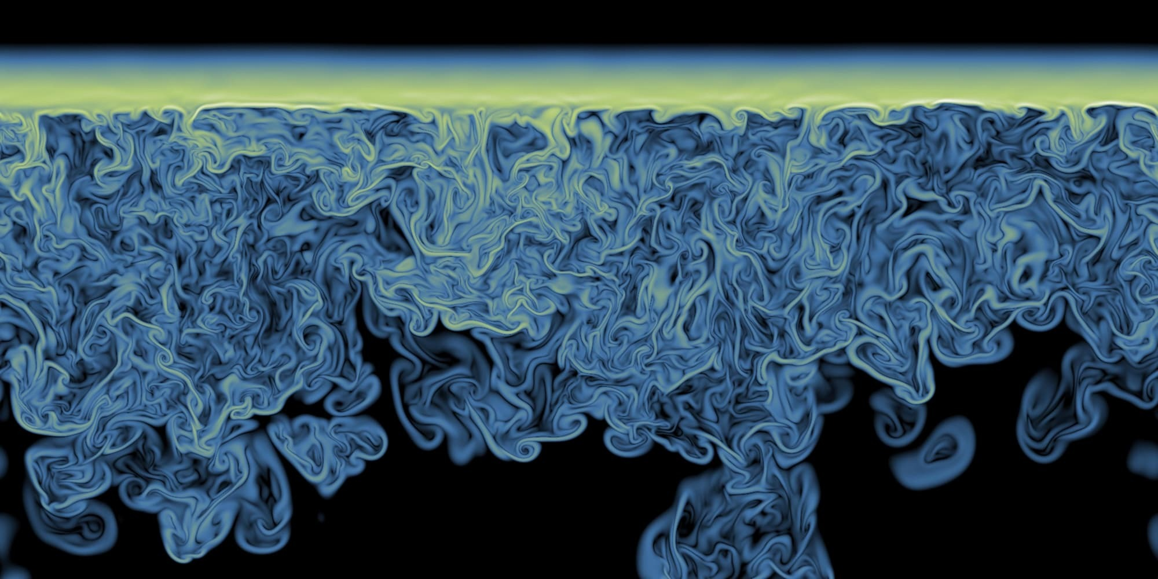
PHYS 4017 - Fluid Mechanics

Slide 2
Class info
When & where: Wednesday 13:20 – 16:20 @ 新物406
Instructor: Chia-Yu Hu 胡家瑜
Office: R804, Astro-Math Building
Email: huchiayu@phys.ntu.edu.tw
Office hours: by appointment?

Slide 3
Textbook(s)
(1) Modern Classical Physics: Optics, Fluids, Plasmas, Elasticity, Relativity, and Statistical Physics, by Kip S. Thorne and Roger D. Blandford http://www.pmaweb.caltech.edu/Courses/ph136/yr2012 (Chaps. 13 – 19)
(2) The physics of astrophysics II: Gas dynamics, by Frank H. Shu
(3) Fluid Mechanics, by L. D. Landau, E.M. Lifshitz

Slide 4
Grading
Homework (5 assignments) 70%
You are encouraged to discuss with your classmates! However, you must complete the homework by yourself. Homework is due a week after distribution. Late homework receives -10% penalty per day (so after 10 days don’t bother…)
Final Exam (closed book, cumulative) 30%
12/18 (Wed.) in class
Participation (come sign up!) up to 3% extra credits
Volunteer to summarize what we’ve learned last week on stage (~ 5 mins) in the beginning of the class.

Slide 5

Why are you here?

Slide 6
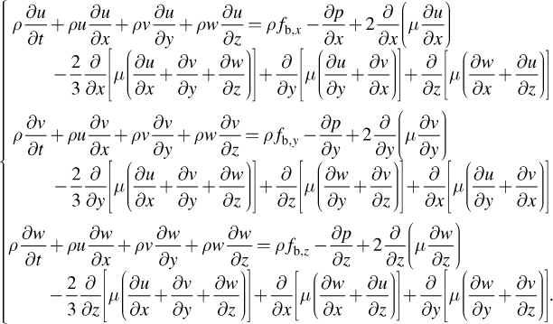
Now, we can dive right into it…

Slide 7

Now, we can dive right into it…

Slide 8
Teaser

Slide 9
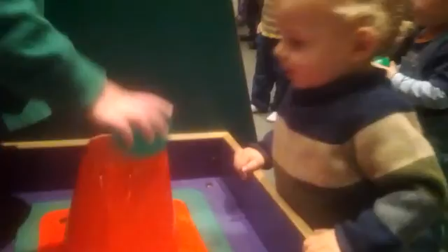

Slide 10
What phenomenon was that?
(a) Magnus effect
(b) Coanda effect
(c) Kelvin-Helmholtz instability
(d) Magnetic confinement
(e) Vortex stretching
(f) Shock waves

Slide 11
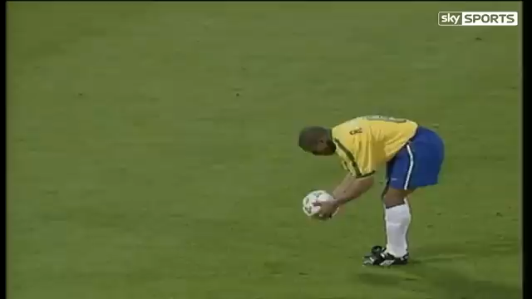

Slide 12
What phenomenon was that?
(a) Magnus effect
(b) Coanda effect
(c) Kelvin-Helmholtz instability
(d) Magnetic confinement
(e) Vortex stretching
(f) Shock waves

Slide 13
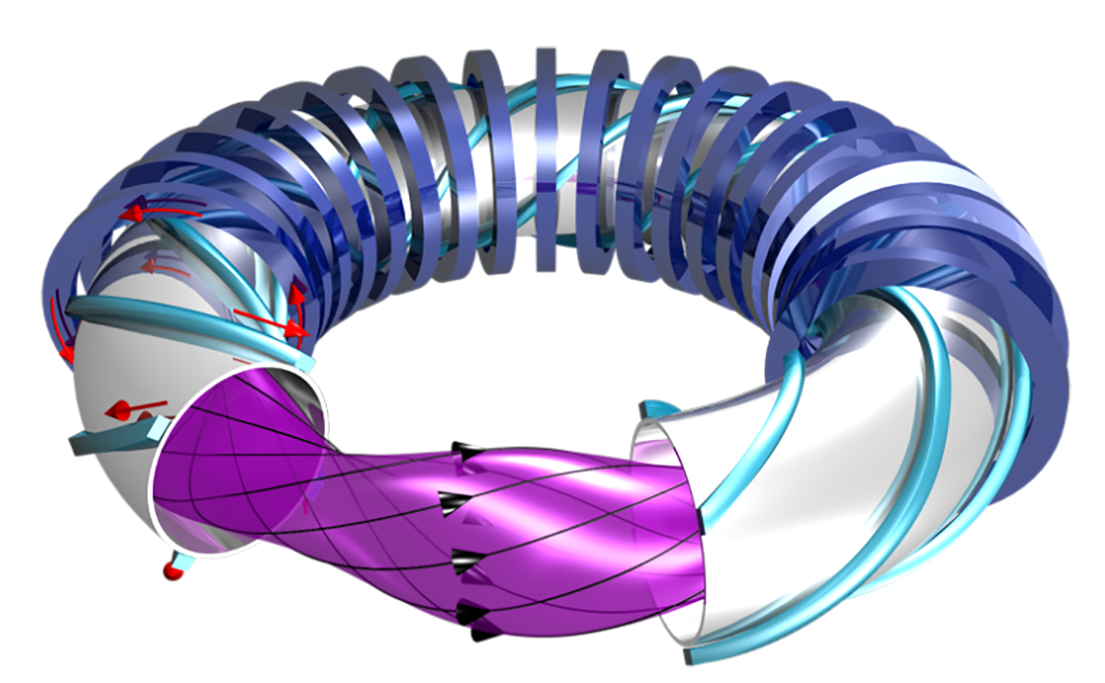
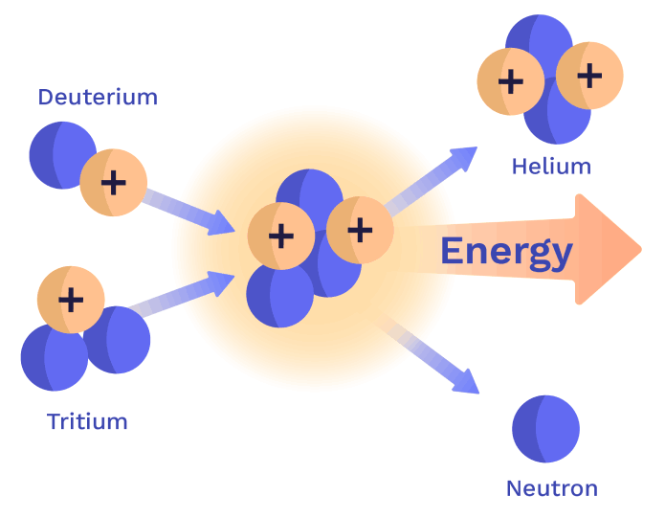

Slide 14
What phenomenon was that?
(a) Magnus effect
(b) Coanda effect
(c) Kelvin-Helmholtz instability
(d) Magnetic confinement
(e) Vortex stretching
(f) Shock waves

Slide 15
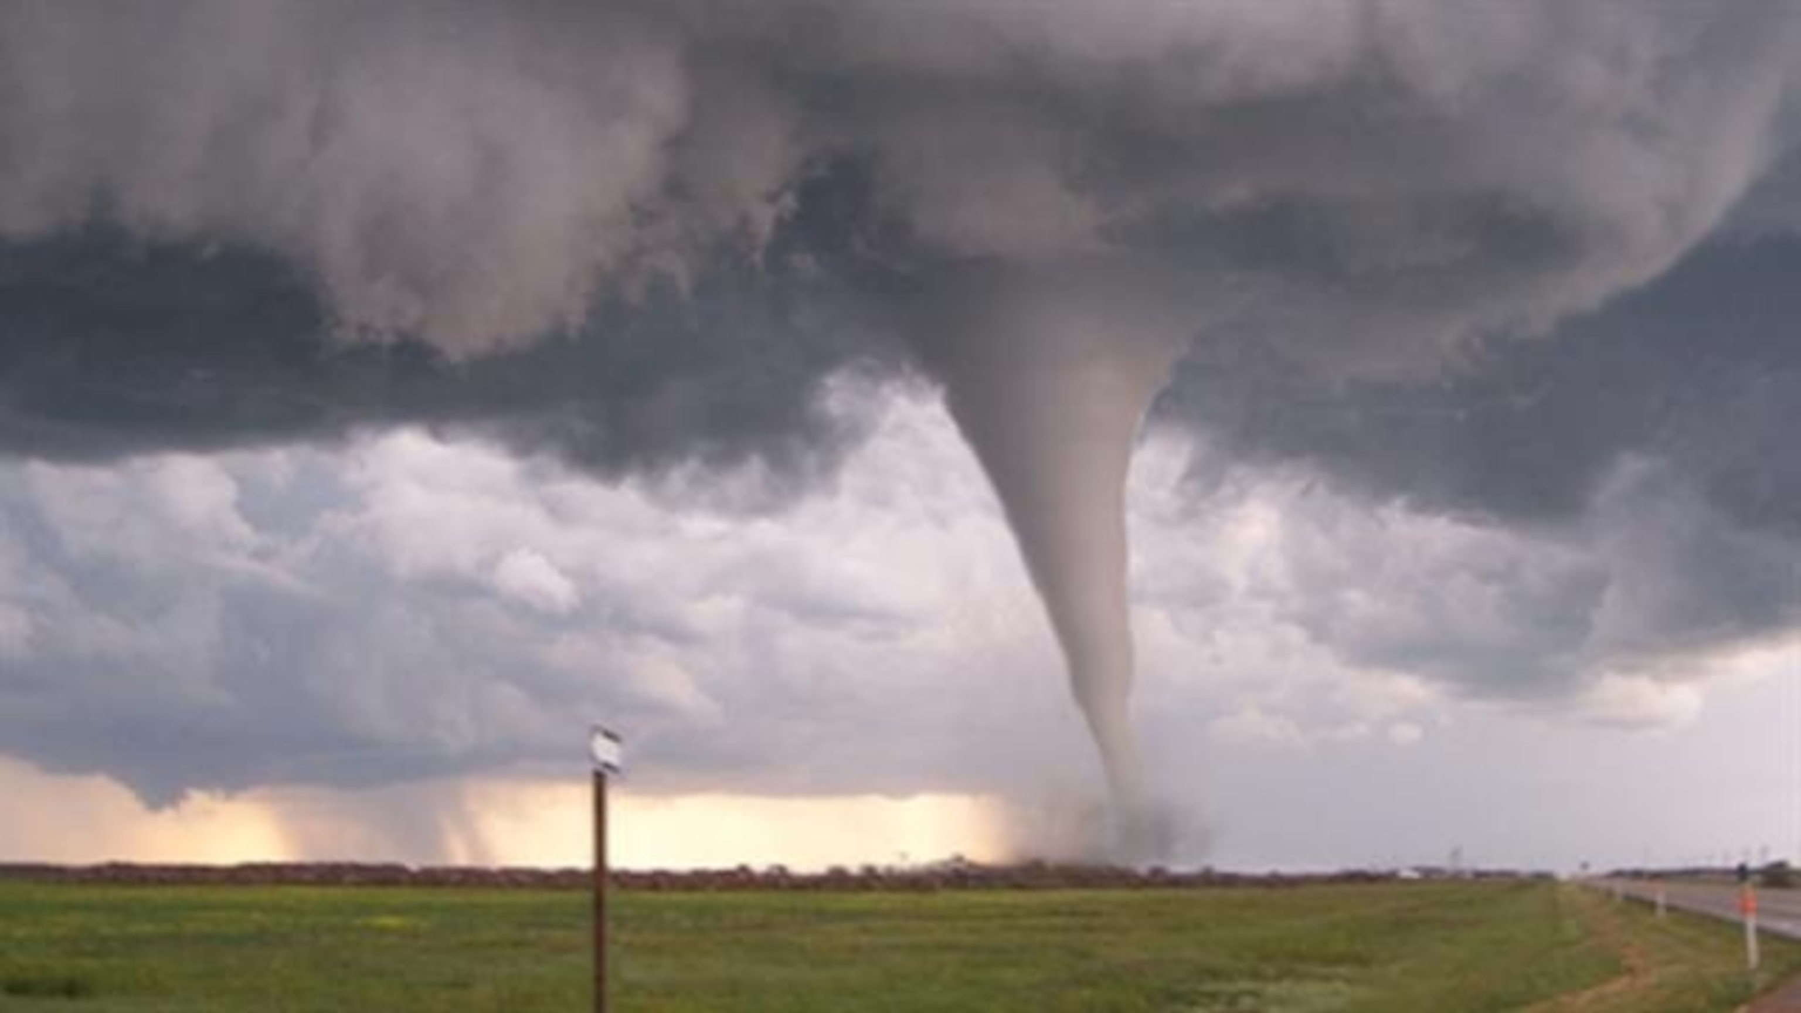

Slide 16
What phenomenon was that?
(a) Magnus effect
(b) Coanda effect
(c) Kelvin-Helmholtz instability
(d) Magnetic confinement
(e) Vortex stretching
(f) Shock waves

Slide 17
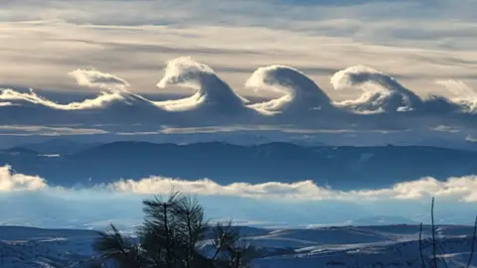

Slide 18
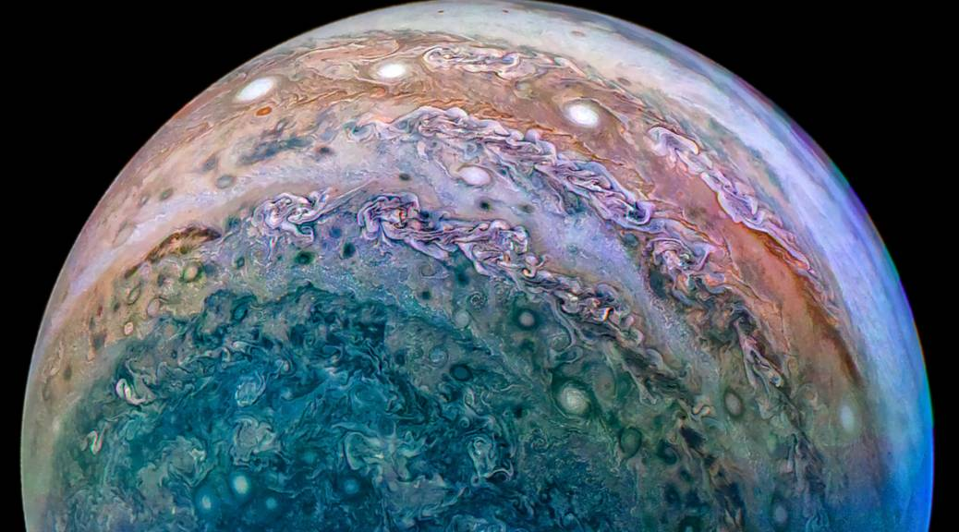

Slide 19
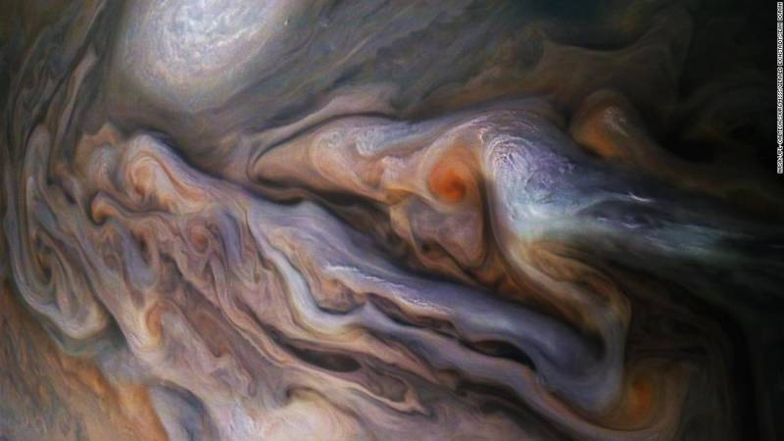

Slide 20
What phenomenon was that?
(a) Magnus effect
(b) Coanda effect
(c) Kelvin-Helmholtz instability
(d) Magnetic confinement
(e) Vortex stretching
(f) Shock waves

Slide 21
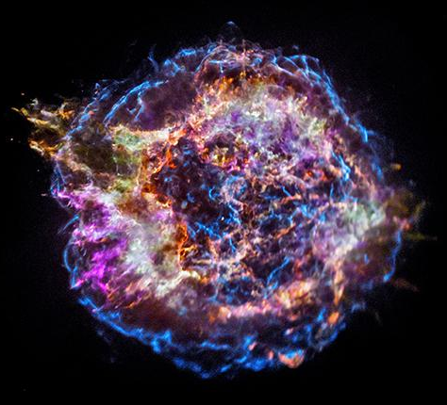

Slide 22
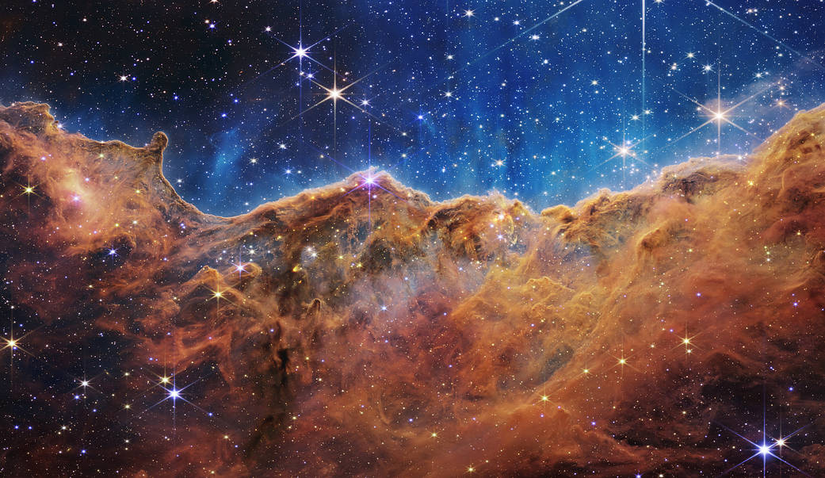

Slide 23
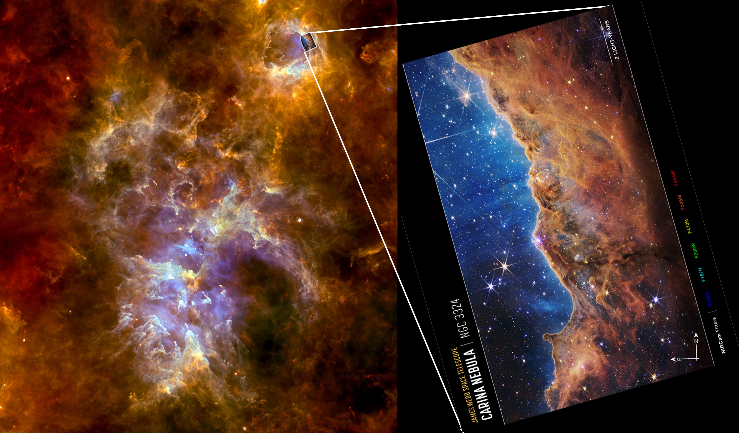

Slide 24
What phenomenon was that?
(a) Magnus effect
(b) Coanda effect
(c) Kelvin-Helmholtz instability
(d) Magnetic confinement
(e) Vortex stretching
(f) Shock waves

